Slide 1
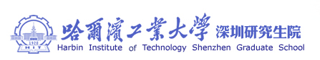
Motion Control：Lecture 1.4
Introduction to course
Jiangang Li
Nov 12 2016
Goals:
Give an overview of MC: Course structure & administration

Slide 2
Text Book
Suk-Hwan Suh, Seong-Kyoon Kang, Theory and design of CNC systems .2008 Springer-Verlag London Limited.
Robert Munning Schmidt etc, The Design of High Performance Mechatronics, Delft University Press, 2011
Piegl, L. and Tiller, W., The NURBS Book, 2nd edition, Springer, 1997

Slide 3
Reference
Karl J. Åström and Richard M. Murray, Feedback Systems: An Introduction for Scientists and Engineers, Princeton, 2008
R.M. Murray, Z. Li, and S. Sastry, A Mathematical Introduction to Robotic Manipulation, CR Press, 1994
L.N Lopez de Lacalle, A.Lamikiz, Machine tools for high performance machining ,Springer.2009

Slide 4
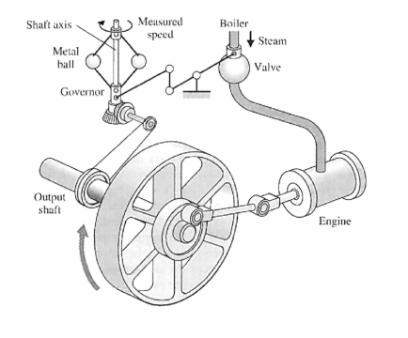
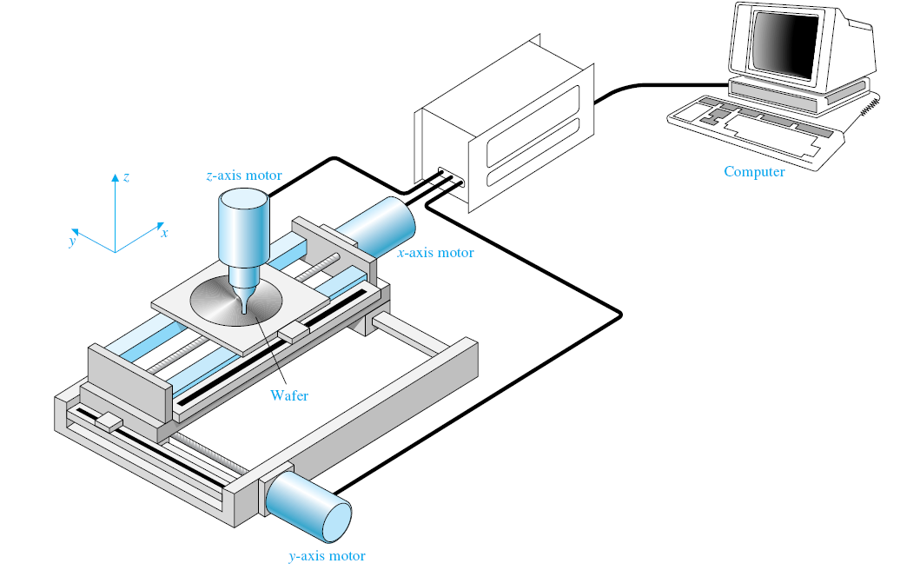
1 Introduction
Course Outline
Watt’s flyball governor
Computer control system

Slide 5
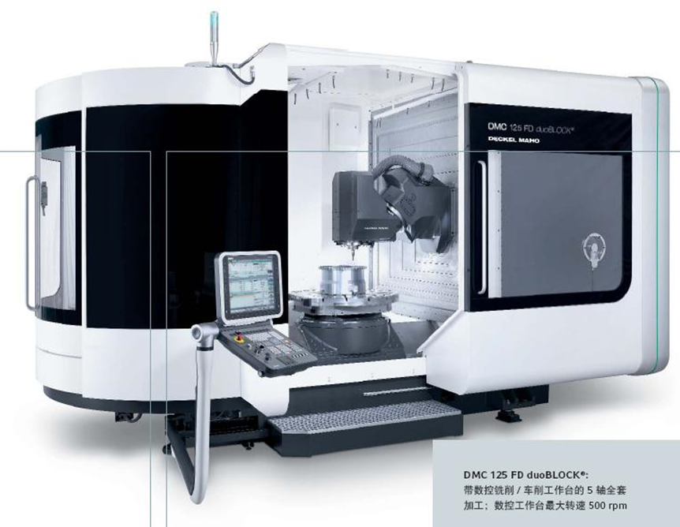
1 Introduction
Motion Control System in industry
Hardware and software structure of Control
Mechanic structure
Motor and Driver
Sensor
CNC Machine tool

Slide 6
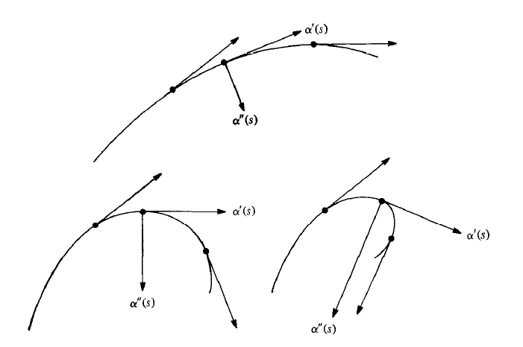
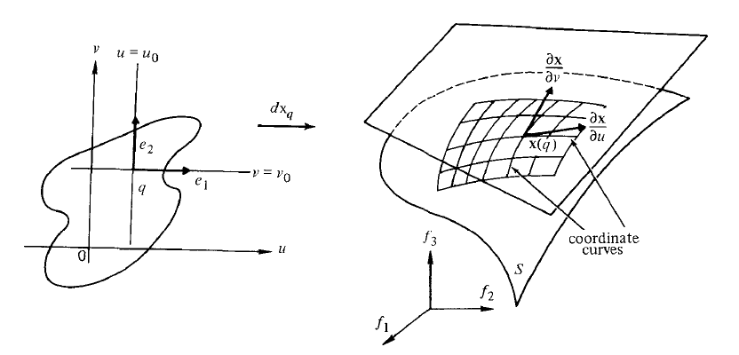
2 Differential Geometry of Curves and Surfaces
  Differential Geometry of Curves and Surfaces
Curves
Surfaces

Slide 7
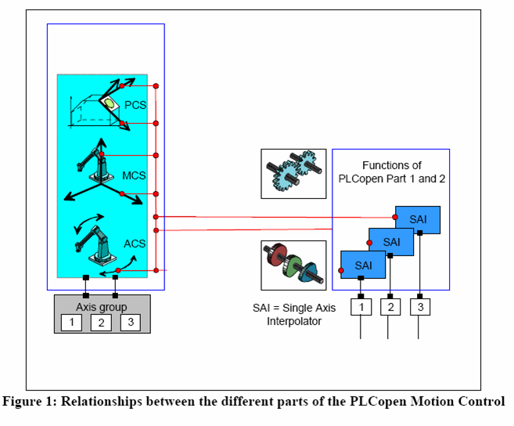
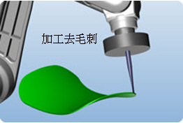
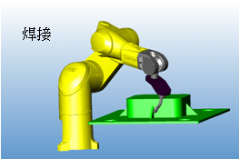
3 Kinematics
  Kinematics(Forward and inverse)

Slide 8
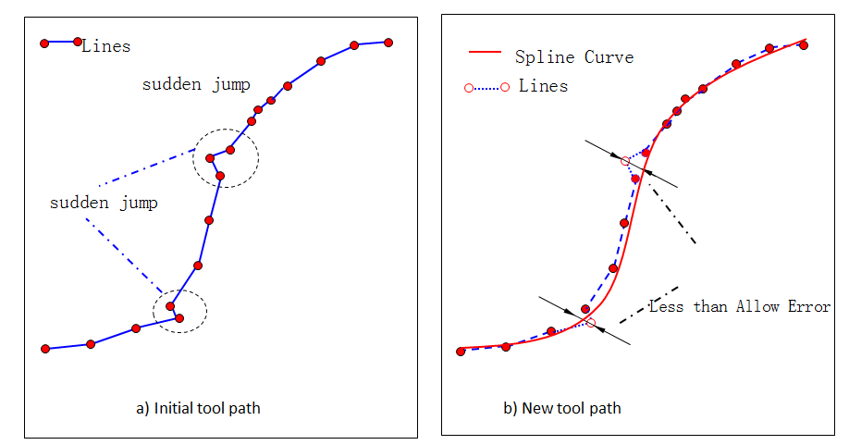
4 Smoothing path
  Smoothing path
Spline Curve Fitting

Slide 9

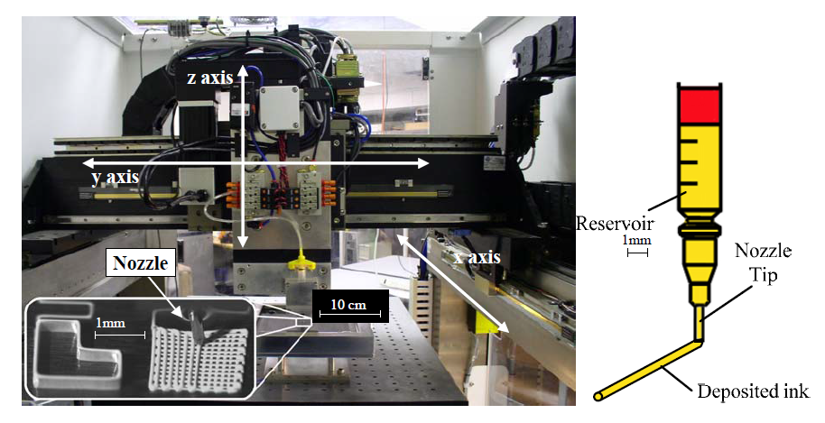





5 Trajectory Planning
  P to P Velocity Planning and Interpolation
Liquid Handle Robot with Point to Point moving
Position, Velocity, Acc,
Jerk

Slide 10
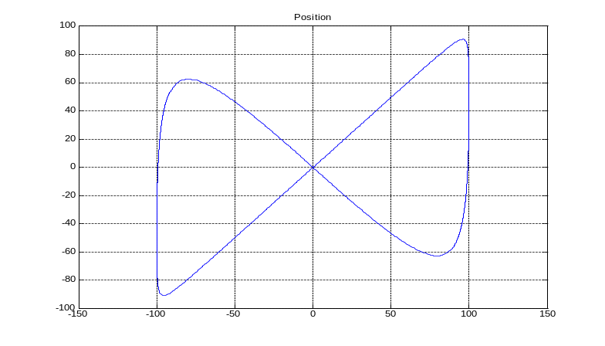
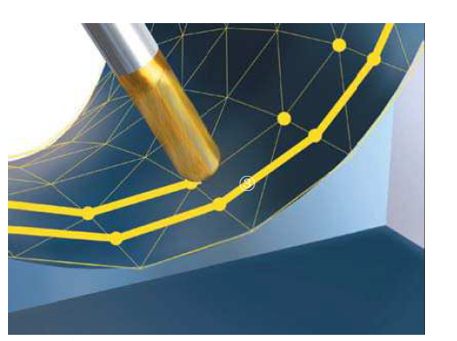

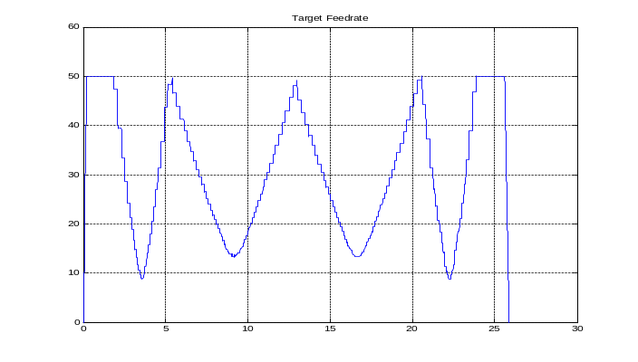

5 Trajectory Planning
  Contour Velocity Planning and interpolation
  (Continuous short line)
Continuous tool path for simulation
Feedrate planning with
Machining time is about 25s

Slide 11
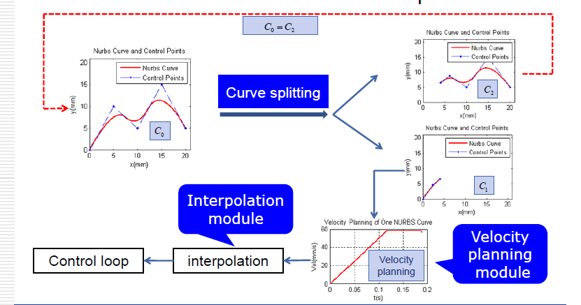
5 Trajectory Planning
  Velocity planning and interpolator for NURBS Curves
Nurbs Interpolator—Online type

Slide 12
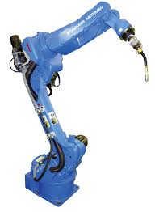
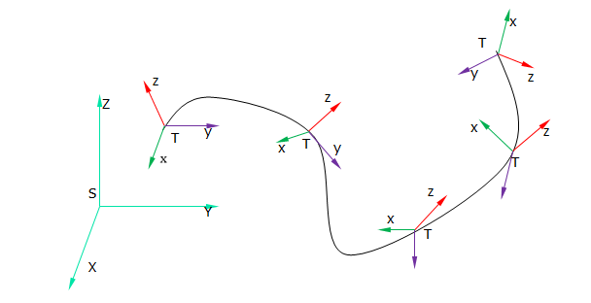
5 Trajectory Planning
  Velocity planning and interpolator for Multi-Axis System
  ----five axis MT, Industry robot
6-Freedom industry robot
Motion in workpiece frame

